Slide 1

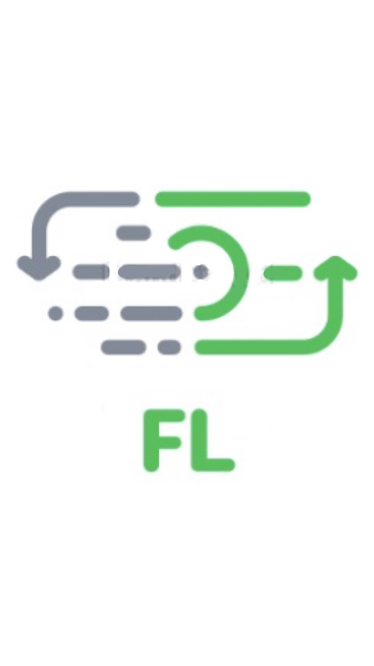
FL TECH
Hackers: Comet, Hannah, Jade, Megha

Slide 2

THE PROBLEM:
Students do not have time to track and manage their
daily spending decisions.

Slide 3
MEET SARAH (TARGET USER):
“I just checked my bank account and I cannot believe how much I’ve spent this past month! I wish someone would tell me when to stop buying bubble tea because I have little to no disposable income left for the semester”
Sarah Foster, Undergraduate Student

Slide 4

THE SOLUTION
FL Tech’s new application, designed with students
in mind to provide real-time financial guidance and
advice on daily purchase decisions.

